Slide 1
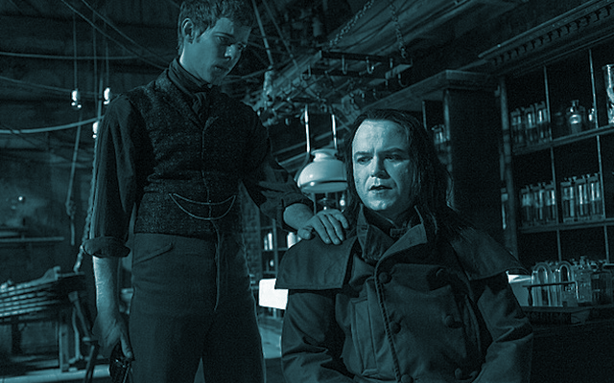
Frankenstein
Microservices
Michael Hamrah
@mhamrah / Chief Architect @NamelyHR

Slide 2
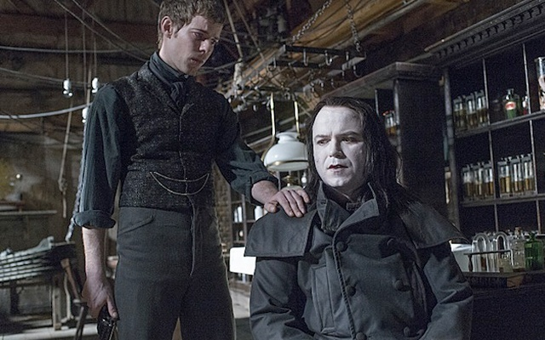

Slide 3
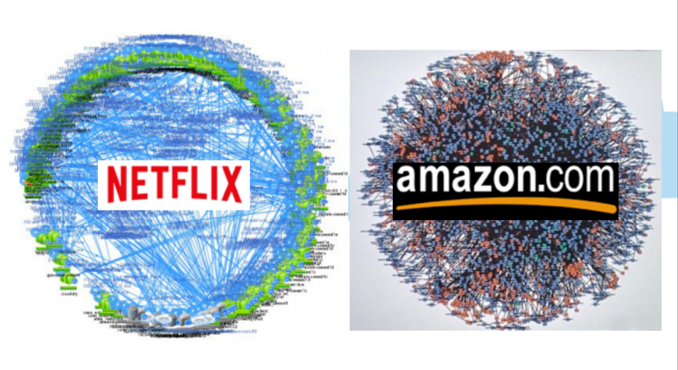
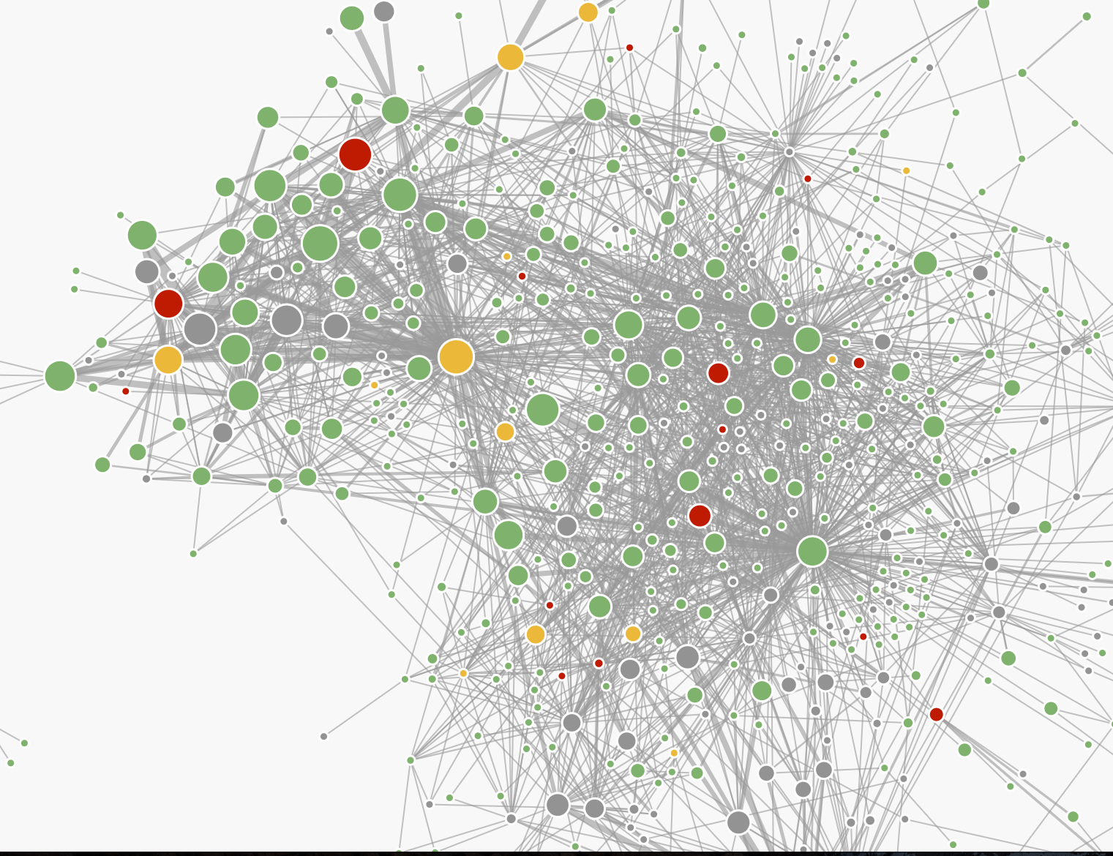

Slide 4
https://segment.com/blog/goodbye-microservices/
https://news.ycombinator.com/item?id=14415485

Slide 5
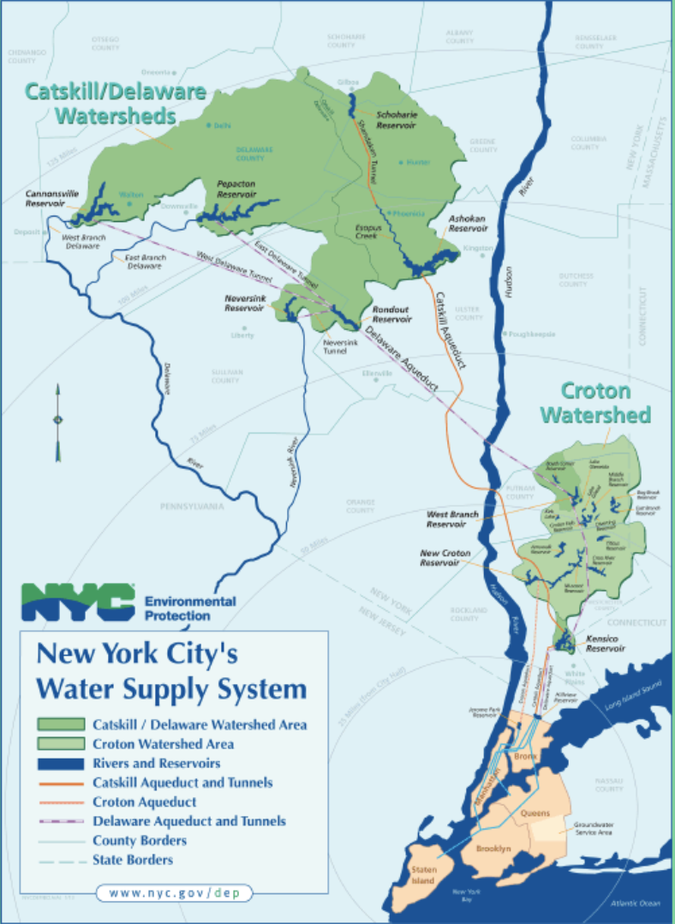
Transportation
As Reliable As Running Water

Slide 6
‘Microservices’ is not an architecture
Notes:
Microservices is a way an organization chooses to operate. It’s more than designing services- you need to create a platform for microservices.

Slide 7
Services Power Products
Infrastructure Powers Platform
Notes:
You’re going to have a lot of little running services. You need to manage them. K8S, DCOS, etc are a means to an end- like a knife. You can cut your hand or make a great meal. You need to decide how to use it.

Slide 8
What is a Service?
Owns Data and Function
Prevent Coupling
Creates Opportunity
Has an SLO

Slide 9
Dependencies
Not Your App
Frameworks
Help You
Focus Here
Core
Notes:
This is how you should think about services.

Slide 10
Notes:
When you have a lot of these, the platform emerges. What’s in the middle is where you should focus your effort. The outside rings and the interconnections are your platform.

Slide 11
What’s in a Platform?

Slide 12
Ownership
Notes:
Ownership: who owns what?

Slide 13
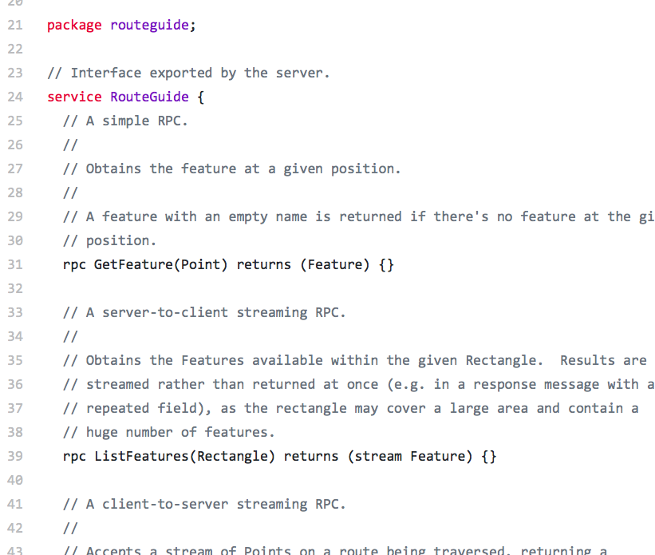
Pick a
Serialization +
Transport
We ♥ gRPC
Notes:
GRPC is a better choice

Slide 14
rpc UpdateTodo (UpdateTodoRequest) returns (Todo ) { option (google.api.http) = { patch: "/todos/{todo.id}" body: "todo" }; }
HTTP Call
grpc-gateway
gRPC
$ docker run -v `pwd`:/defs \
namely/gen-grpc-gateway -f todos.proto -s Todos
$ docker build -t todos-gateway gen/grpc-gateway

Slide 15
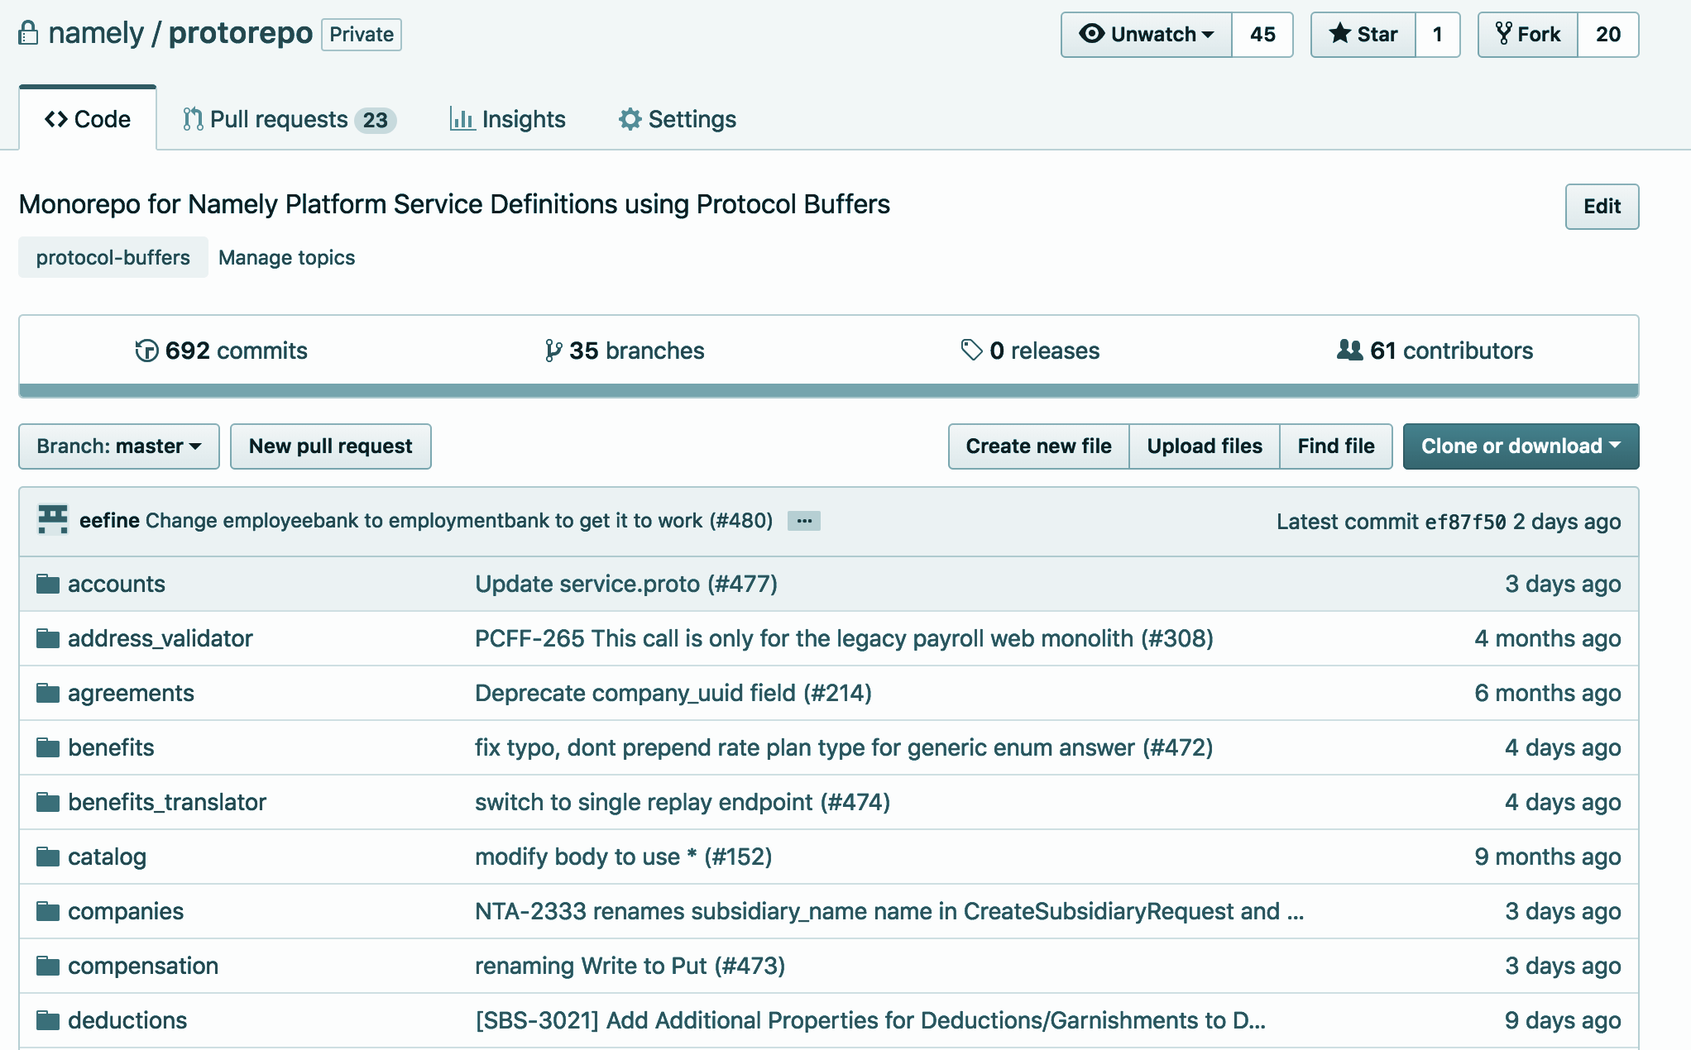
Make Integration
Easy

Slide 16
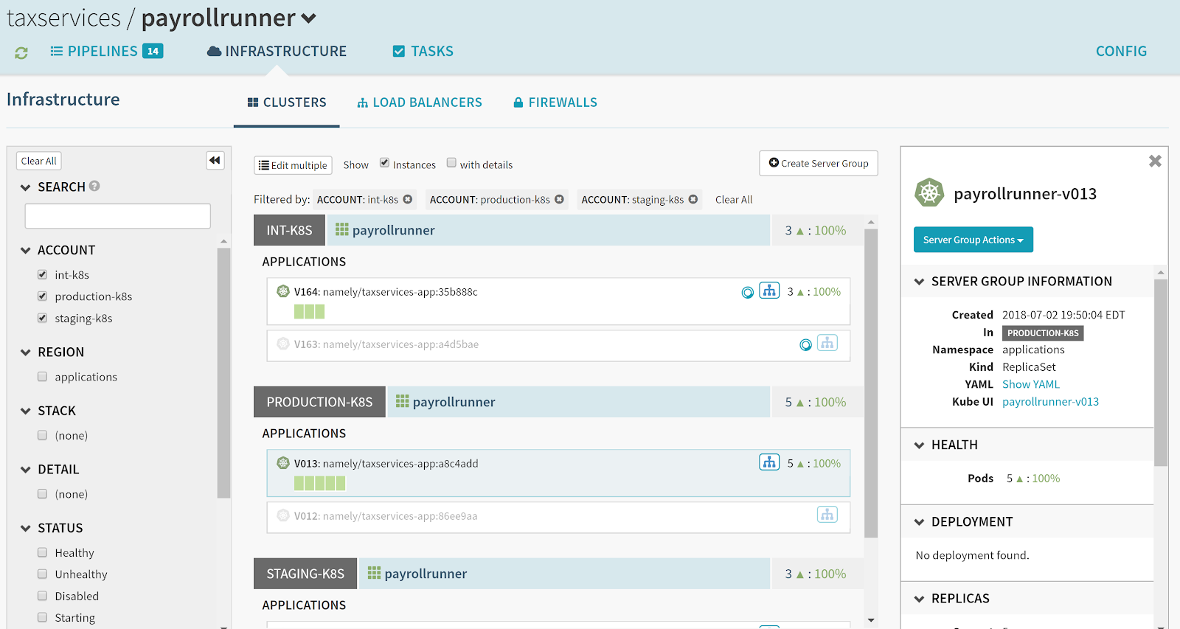
Deployments
Most outages occur from
a bad deploy
How is it running?
Who deployed what?
How much traffic?
Is it stable?
Can you rollback?
Notes:
Deployments are important. Who deployed what and when? How are you rolling out? How do you rollback?

Slide 17
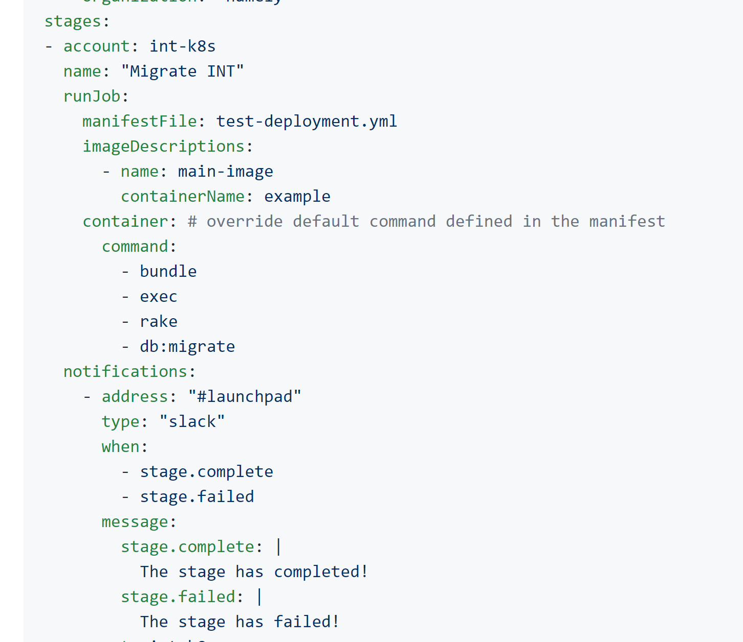
Pipeliner + Estuary
https://github.com/namely/k8s-pipeliner
Pipeliner is a simple yaml configuration for Spinnaker.
Estuary automagically applies pipelines
to Spinnaker.
Single-purpose composable tools are key for any SRE team.

Slide 18
Never Coordinate Deployments

Slide 19
Service Discovery and
Traffic Management
Service Pack
Service A
300ms Timeout x 3
Service Pack
Deadline 400ms Budget 20%
Service Lack
Service B
300ms Timeout x 3
Service Lack
Deadline 200ms Budget 20%
Service Mack
Service C
Service Mack
Notes:
Load Balancing
Circuit Breaking
Retries and Deadlines
Security
Synthetic Load
Traffic Shifting
Debugging & Observability

Slide 21
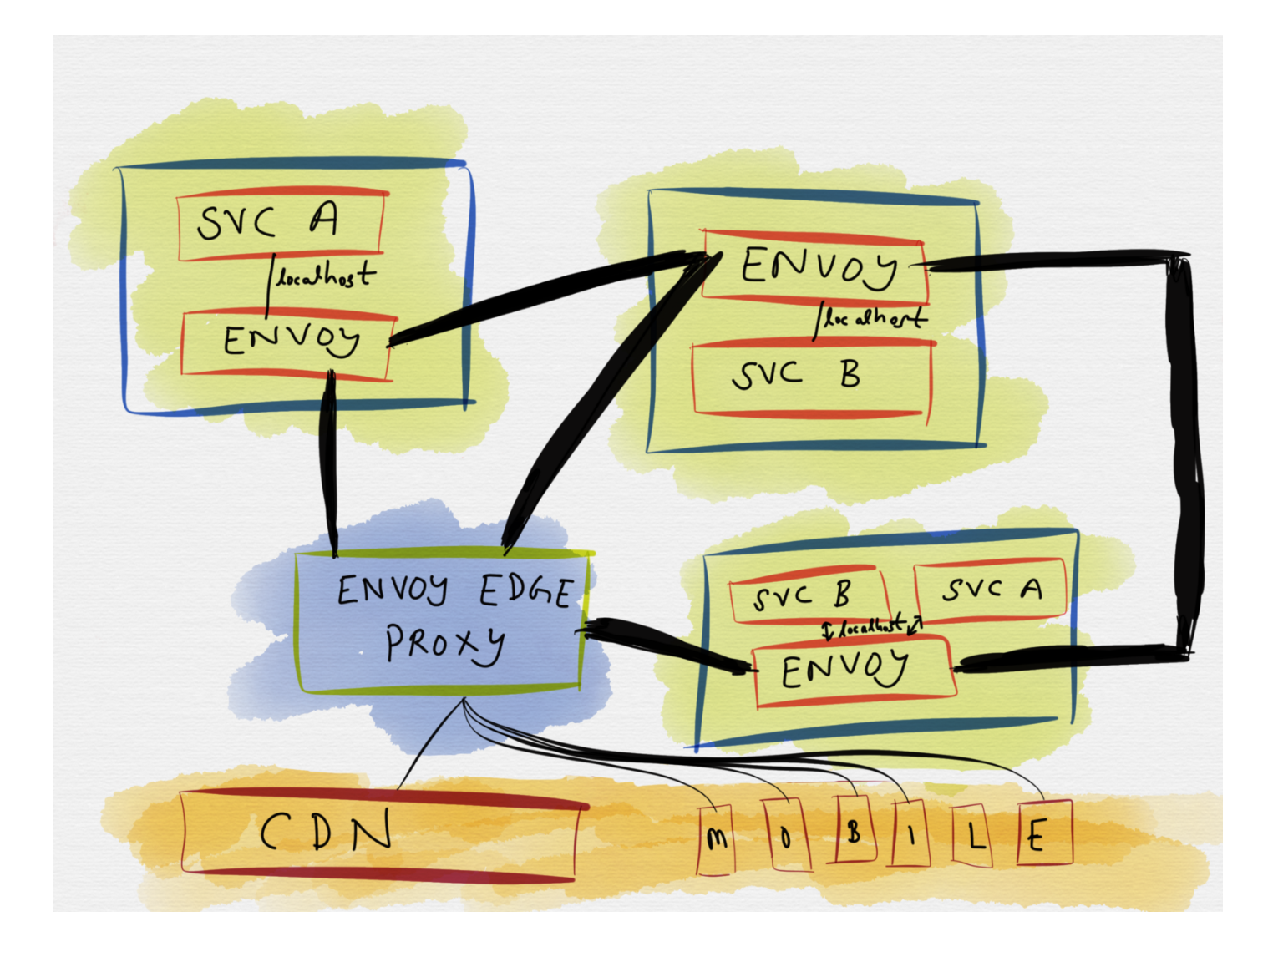

Slide 22
Live vs Background Processing
Orders
Create Order
Order Created
Oldest
Order Created:
Pixel
Order Created:
iPhone
Shipments
Analytics
Notes:
* user request is api driven
* kafka for passive calculations (surge pricing, feeds back into service)

Slide 23
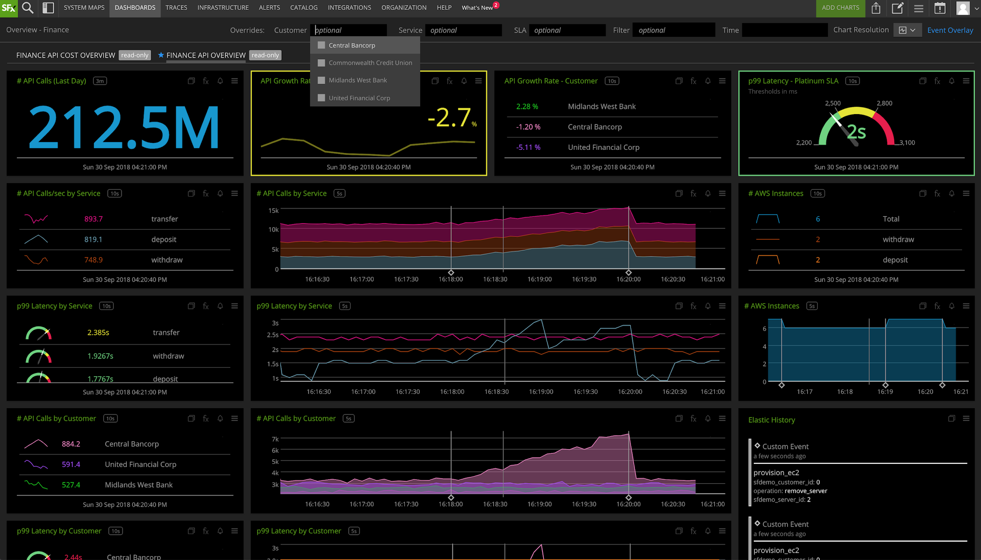
Notes:
Monitoring must be a standard, first class citizen in your organization. You need to understand service health.

Slide 24
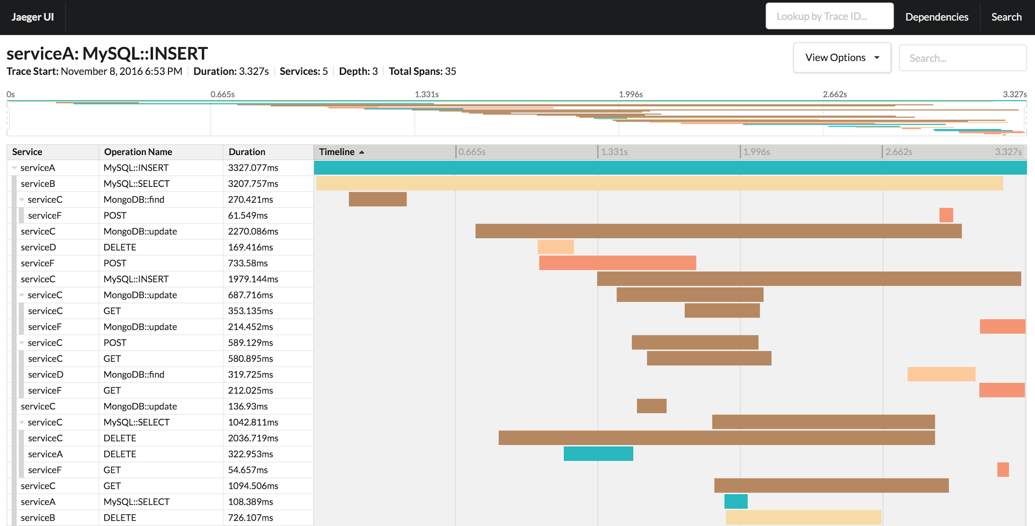
Notes:
But you also need a request view. Distributed tracing gives you the big picture from an end user standpoint.

Slide 25
Chaos Engineering
Putting Failure First

Slide 26
Notes:
Your actual landscape is complex. You have blue/green deployments, global sharding, stateless and stateful, edge proxies.

Slide 27
Build
A
Platform
Make DevEx great
Ownership is a feature
Observability is a feature
Deployments are a feature
Traffic Management is a feature
Standards are important but not absolute
Notes:
what can you get for free? metrics/alerting. frameworks case.

Slide 28
Know
Your
Tools

Slide 29
The End

